Slide 1





Presented by
Group 4
Explainable AI and Data Story Telling
Bridging the Black Box with Narratives
Himadri Joy Bepari, Jing Chen, Le Hsu, Shu-Pei Huang, Varun Arun
1

Slide 2

Presented by
Group 4
Team Members
Varun Arun
Himadri Joy Bepari
Jing Chen
Focus on XAI foundations, technical approaches, and limitations.
Focus on Narrative-driven XAI and how LLMs empower storytelling.
Focus on Human-AI collaboration and why AI isn't a panacea for data workers.
Shu-Pei Huang
Le Hsu
Find applied field to bridge theory with practice. Supplement regulatory frameworks and authentication of AI.
Coordinate a 50-minute seminar by shaping a clear narrative, audience journey, design an audience interaction, and a unified final deck.
2

Slide 3




Rising AI Adoption, Trust Remains Challenge
The intelligent age has arrived
Trust remains a critical challenge
AI regulation
AI at work
66% of people use AI regularly, and 83% believe the use of AI will result in a wide range of benefits.
Yet, trust remains a critical challenge: only 46% of people globally are willing to trust AI systems.
There is a public mandate for national and international AI regulation with 70% believing regulation is needed.
Many rely on AI output without evaluating accuracy (66%) and are making mistakes in their work due to AI (56%).
Data Source: KPMG Global Study (2025) - Trust in Artificial Intelligence
3
Notes:
After our team introduction, let’s look at the reality of the business world today. According to the 2025 KPMG Global Study, we are living in a 'Trust Paradox.' > As you can see on the screen, 66% of global users are now using AI in their daily workflows. It is everywhere. However, only 46%—less than half—are actually willing to trust the decisions these systems make.
This leaves us with a dangerous 20% Trust Deficit. Furthermore, 71% of people are now demanding strict regulation and, most importantly, Transparency.
Legal Drivers: EU GDPR "Right to Explanation."
This is exactly why we are here today. To close this gap, we don't just need faster AI; we need Explainable AI (XAI). We need to turn that 'Black Box' into a story that humans can trust.
Led by the University of Melbourne in collaboration with KPMG, Trust, attitudes and use of Artificial Intelligence: A global study 2025opens in a new tab, surveyed more than 48,000 people across 47 countries to explore the impact AI is having on individuals and organizations. It is one of the most wide-ranging global studies into the public’s trust, use, and attitudes towards AI to date.
The findings reveal that AI adoption is on the rise, but trust remains a critical challenge - reflecting a tension between the benefits and risks:

Slide 4




Seminar Overview: Explainable AI
FOUNDATION
TRANSFORMATION
SYNERGY
The Technical Taxonomies
Narrative-Driven XAI
Human-AI Collaboration
Source, Logic, & Representation
Mapping XAI to Stakeholders
Technical Boundaries
LLMs as Translators
SHAPstories & CFstories
Memorability vs. Complexity
Planning, Implementation, Communication.
4 Roles of AI Collaborators
Agency vs. Automation
4
Notes:
To bridge the trust gap we just discussed, we’ve structured today’s seminar into three distinct phases. You can see this as our XAI Value Chain.
Phase 1: Foundation. We start with the 'Brains.' Led by Role A, we will dissect the technical taxonomies of XAI. We need to understand how models are categorized based on their logic and sources before we can explain them to others.
Phase 2: Transformation. This is where the magic happens. Role B will show us how to turn cold technical data into human-centric narratives. We will introduce SHAPstories—using LLMs to ensure that an explanation isn't just accurate, but actually memorable and persuasive.
Phase 3: Synergy. Finally, Role C will bring us into the real world. We will analyze the data worker's workflow—from planning to communication—to see how AI can act as a creator, optimizer, or reviewer, while maintaining our professional integrity.
By the end of these 50 minutes, you will have a complete toolkit to navigate the future of AI trust.

Slide 5




What is Explainable AI?
Why XAI Matters
Methods that make AI decisions transparent and interpretable.
Core principles
Transparency
Interpretability
Fidelity
Actionability
Modern AI are accurate but opaque.
Black boxes
Who needs explanations?
Consequence of lack of opacity:
Lack of trust
Hard to debug, regulate, validate
Poor communication of insights
End-users
Domain Experts
Developers & Engineers
Regulation
Trust, reassurance, accountability
Doctors, lawyers, and analysts
Validation and decision support
Debugging, bias detection, model improvement
Fairness, compliance, transparency
5

Slide 6
Technical Approaches to XAI
Source-oriented
Representation-oriented
Logic-oriented
Where explanations come from
Objective: data & model behavior
Subjective: human expertise & context
How explanations are shown
Visual: heatmaps, attention maps
Symbolic: numbers, rules, text
Hybrid: visuals + text (best for storytelling)
What is explained
End-to-end: input → output (e.g., SHAP, LIME)
Intermediate: internal model reasoning
Correlation-based: feature & temporal relationships
6

Slide 7
Limits of XAI
Oversimplification
Explanations may hide real complexity
Risk of misleading “plausible” stories
Storytelling Matters
User Mismatch
Data storytelling starts where XAI ends
Tailoring explanations to audience
Acknowledging uncertainty and trade-offs
Turning explanations into decisions
Same explanation does not work for:
Novice users
Experts in their respective fields
False Sense of Trust
An explanation can be wrong but convincing
7

Slide 8
Current Approaches to XAI for prediction models
instance-level XAI
problems
prediction for a single instance
feature attribution methods (SHAP)
methods that show which feature values matter most for a prediction, using weights
counterfactual (CF) methods
the smallest set of evidence in a data instance whose removal would change the decision
mismatch exists because:
built for researchers, not end users
created manually
not in natural language narratives
Goals
Bridging the gap between metrics and human understanding.
8

Slide 9


Solution: XAIStories
Combine XAI methods, specifically SHAP values or CF explanations, with LLMs.
SHAP values
LLMs
SHAPstories
CF explanations
LLMs
CFstories
9

Slide 10



Guess Game: why is it misclassified?
Is that a Bird? Is that Plane?
Does he Break Dance? Break something?
Join at menti.com
Use code: 7356 2766
Misclassification: missile
Misclassification: unicycle
10

Slide 11

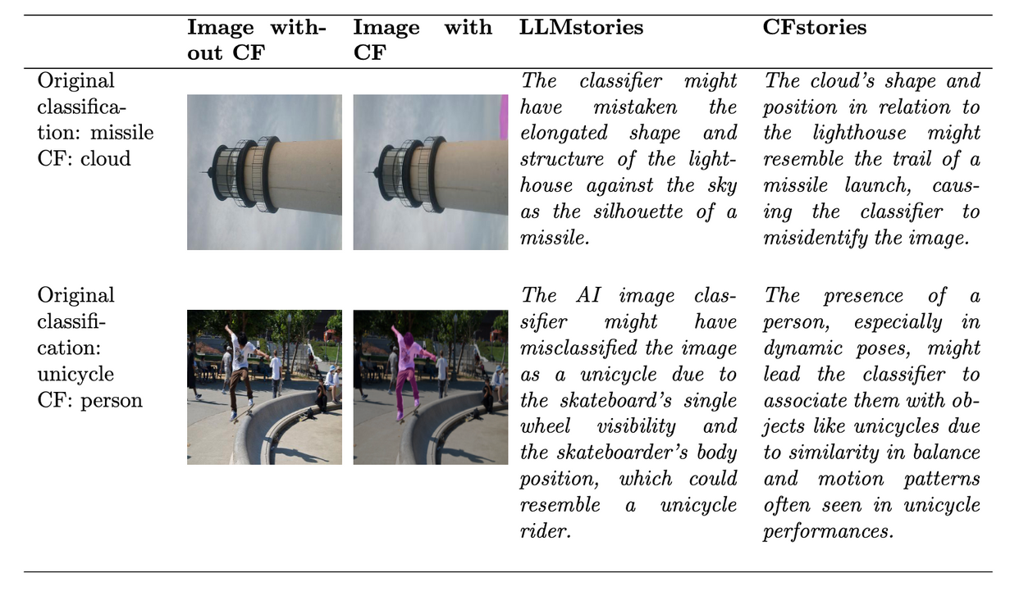
CFStories
CF explanations
LLMs
CFstories
context of image classification: Semantic Counterfactuals for Accurate Picture (SCAP) explanations.
Identify meaningful image segments whose alteration (Ex, blurring) changes the predicted class.
then use of Multi-modal LLMs such as GPT-4o.
Focus on misclassified images, since counterfactuals for correct predictions are trivial.
11

Slide 12

SHAPStories
SHAP value
LLMs
SHAPstories
context of tabular classification:
Describe the dataset, target variable, and features.
Explain the SHAP prediction, including the predicted class and correctness.
Instruct the LLM to generate a brief story using only the most important (highest SHAP) features.
Limit the explanation to eight sentences, end with a summary, and include a table of feature values and SHAP scores.
12

Slide 13
Assesment: Evaluation by Humans
Four surveys:
differing in the target audience (lay users versus data science experts),
XAIstory (SHAPstory vs CFstory), and
evaluation (user experience vs decision making and understanding)
Technical Plot vs. Narrative(SHAPplot vs SHAPstory)
Four dimensions:
Ease: The narratives were easy to understand.
Confidence: The narratives increased confidence in understanding the prediction.
Speed: The narratives enabled faster understanding of the prediction.
Usefulness: The narratives are a valuable and desirable addition to AI models.
13

Slide 14
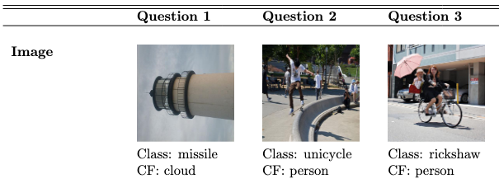
Striking Results: Comprehension Leap
CFstories:
CFstories provide better explanations with better reasoning.
75.4% of all respondents find CFstories as convincing.
The average evaluation time is 5 seconds, indicating a significant speed advantage.
Limitation:
Not all CFstories are convincing.
On top of CF, users want additional features—such as orientation.
14

Slide 15
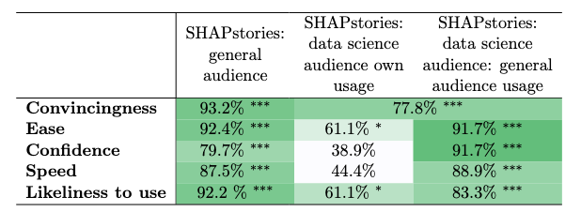
Striking Results: Comprehension Leap
SHAPstories:
SHAPstories are clear, natural, and sufficiently detailed for non-experts.
93.2% of the general audience finds SHAPstories convincing. Data science audience similar to positive results 77.8%.
81.4% valuable addition to the SHAP plots
Limitations:
It focuses on key features and offers an interpretive narrative where no standard SHAP interpretation exists.
SHAPstories makes underlying assumptions that are not necessarily correct.
Six respondents see little added value, noting that SHAP plots and tables already convey the same information.
15

Slide 16
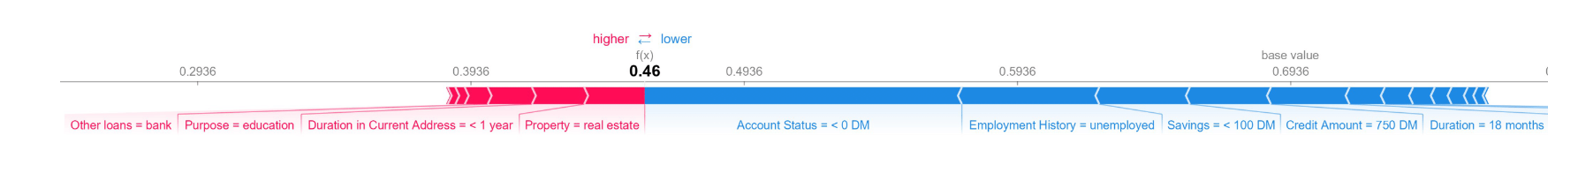
Quality: Technical Plot vs. Narrative
Comparision:
In the credit-scoring scenario, SHAPstories significantly improved users’ objective understanding of why the AI approved or rejected a loan compared to SHAP plots.
Users with SHAPstories were far more accurate in summarizing the model’s reasoning and in anticipating how feature changes would affect decisions.
Although SHAPstories required slightly more reading time, this extra time led to higher decision accuracy, not confusion.
In contrast, SHAP plots did not meaningfully improve understanding and reduced user confidence when users spent more time interpreting them.
Overall, the results show that narrative explanations bridge the gap between technical XAI and human decision-making in high-stakes financial contexts.
16

Slide 17
Paper 3: Why is AI not a Panacea for Data Workers?
What is Data Storytelling?
Creating and communicating a series of coherently connected data facts with visualizations and narratives to achieve the author’s goal.
Background of the study:
Human–AI Collaboration in Data Storytelling
Data storytelling is a core activity for data workers such as analysts, researchers and journalists.
But creating good data stories requires many skills
While many AI tools already exist, most of them only support isolated tasks.
What are Data workers?
All people who do data science work, including researchers, data scientists, and business analysts.
Research questions
Where would data workers like to collaborate with AI?
How would data workers like to collaborate with AI?
Why and why not do data workers prefer to collaborate with AI?
17

Slide 18
Research Design
Semi-structured interviews with 18 professional data workers from both academia and industry
Participants included analysts, researchers, journalists, and consultants who have experiences with data storytelling
Interviews explored data workers’ expectations, frustrations, and ideal collaboration patterns with AI
Focus on the entire data storytelling lifecycle: planning, implementation and communication.
Research Results
What is the general workflow of data storytelling?
Why is AI desired in data storytelling?
Why AI is not a panacea for data storytelling?
Where and how do humans want to collaborate with AI?
What should future Human-AI collaborative data storytelling tools look like?
18

Slide 19
1. What is the general workflow of data storytelling?
From the interviews, the study identifies a 3-stage workflow consisting of 7 key tasks:
(1) Planning
Decide the core message
Collect data facts
Compile the story outline
(2) Implementation
Prepare story pieces
Integrate story pieces
Style the story
(3) Communication
Share and present
Data workers mainly want AI in the planning and implementation stages.
The most popular tasks are collecting data facts, preparing story pieces and styling the story.
Interestingly, they are very reluctant to let AI decide the core message.
That is seen as a human responsibility.
19

Slide 20
2. Why is AI desired in data storytelling?
Participants reported four major motivations:
(1) Reducing repetitive work
AI is valued for automating formatting, layout changes, and version control.
(2) Faster & cheaper than humans
AI enables rapid generation of charts, summaries, and alternative designs.
(3) Creative support
AI can suggest diverse ideas and perspectives that humans may overlook.
(4) Low social cost
Users feel comfortable making unlimited requests to AI without social pressure.
20

Slide 21
3. Why is AI not a panacea for data storytelling?
Despite its potential, AI has critical limitations:
(1) Lack of contextual understanding
AI often fails to understand project-specific background and domain knowledge.
(2) Difficulty in expressing intent
Data workers struggle to communicate subtle goals to AI systems precisely.
(3)Risk of misinformation
AI can generate misleading or incorrect explanations.
(4)Ethical and responsibility concerns
Who is responsible when AI makes mistakes? You cannot say “the model did it.”
21

Slide 22
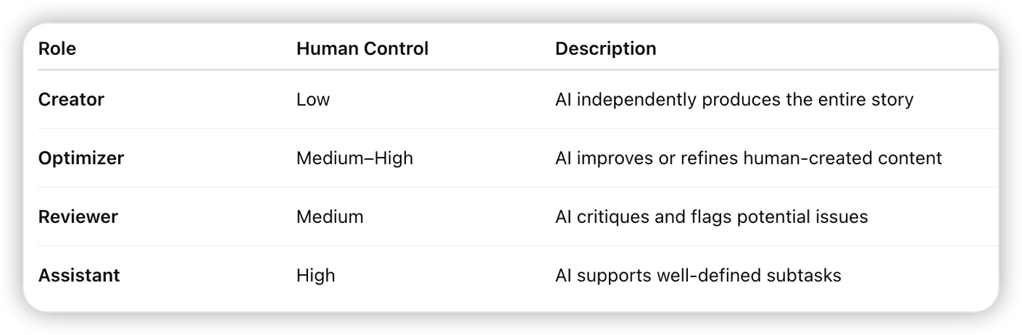
4. Where and how do humans want to collaborate with AI?
Instead of seeing AI as a single tool, participants described four different roles for AI collaborators.
22

Slide 23
5. What should future Human–AI collaborative tools look like?
Future data storytelling tools should:
AI should be flexible & configurable
Allow users to decide how much control they keep
Explain its decisions
Aware of interactions between authors and audiences
Final takeaway:
AI should not replace data workers in storytelling.
Instead, it should act as a supportive, explainable, and adaptable collaborator.
The real opportunity is not full automation, but human-centered AI that helps people tell better data stories.
23

Slide 24
Applied Field
Financial Services - Credit Scoring & Loan Transparency
Case: When AI rejects a loan application.
XAI Function: Provides specific rationale for the decision (e.g., distinguishing between "unstable income" vs. "high debt-to-income ratio").
Healthcare - AI-Assisted Imaging
Case: AI detecting potential tumors in X-rays or MRI scans.
XAI Function: Visualizes the "Focus Area" (e.g., heatmaps) to show exactly which shadow or feature triggered the diagnosis.
Autonomous Vehicles - Safety & Decision Logging
Case: Critical actions or emergency, such as sudden braking
XAI Function: Records the specific cause of action (e.g., identifying an obstacle invisible to the human eye vs. a sensor false positive).
24

Slide 25
Regulatory frameworks
EU AI Act - The Global Regulatory Benchmark
Risk-Based Architecture
Categorizes AI systems by potential threat levels.
"High-Risk AI" (e.g., recruitment, credit scoring, border control) faces the strictest compliance requirements.
Mandatory Explainability
Requirement: High-risk systems must be explainable and transparent.
Implementation: mandates detailed activity logging and clear documentation to ensure human overseers can interpret and validate system outputs.
US NIST AI Risk Management Framework (AI RMF)
Voluntary but Influential
While not a mandatory law, it serves as the primary guideline for AI governance and development in the US.
Defining "Trustworthy AI"
Explicitly identifies "Explainable & Interpretable" as fundamental characteristics of a trustworthy system.
Promotes XAI as a core component of risk mitigation rather than just a compliance checkbox.
*NIST stands for National Institute of Standards and Technology
25

Slide 26
Logic or Fact ?
XAI does not automatically guarantee "Truth."
Instead, it allows humans to validate the "Inference Path" (Reasoning).
Logic Errors
If the answer is right but the logic is wrong: XAI explains the "Lucky Guess."
AI Output: "This is a Husky." (Correct Answer)
XAI Explanation: "I predicted this because I see snow in the background."
Human Verification: The logic is flawed. The AI is relying on context (snow), not features (the dog).
The model is unreliable despite the correct answer.
Fact Errors
If the logic is right but the answer is wrong: XAI explains the "Source/Data/Fact Error."
AI Output: "Lincoln was the 1st President." (Wrong Answer)
XAI Explanation: "I found high co-occurrence of these terms in Training Text A."
Human Verification: The logic is right that the model read the data correctly, but the source data is incorrect ("Garbage In").
Fix the data source or training materials.
If XAI tells you the answer and data source, will you trust it?
26

Slide 27

Future Outlook
Trust & Security
Authentication of AI: Identity Verification and Non-Deception.
Privacy Gatekeeper: Real-time data usage alerts.
Context & Interaction
Evolution toward context-awareness: Scenario-intelligent AI.
Interactive explanations: Human-like rephrasing & tone matching.
Knowledge & Agency
Knowledge Fusion: Technical data + human wisdom.
Changeable Agency: Real-time adjustment of AI’s autonomy.
27

Slide 28
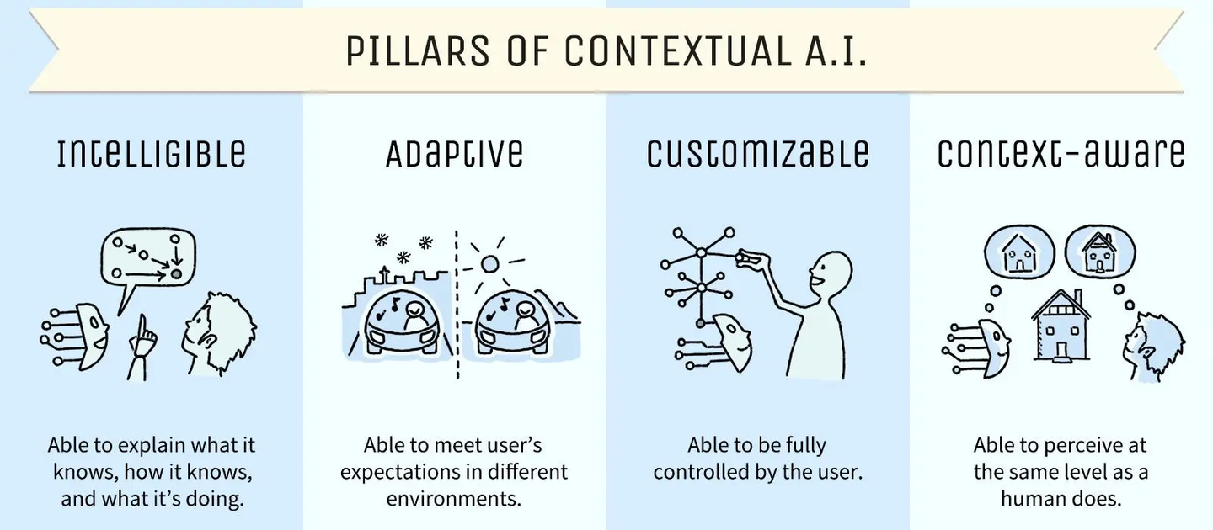
Human-Centric XAI
To create trustworth, ethical, and comprehensible AI that empower human decision-making
The fundamental shift
"Explaining the model" to "Curating the truth”.
1. The Evolution of Interaction
2. The Fusion of Knowledge
Moving beyond static outputs toward context-awareness and interactive, human-like explanations.
Integrating cold technical data with the richness of human expertise and situational wisdom.
28
Notes:
As we wrap up our 50-minute journey, we want to leave you with two core conclusions that define the future of our field.
First, we are witnessing an evolution. XAI is no longer about a one-way technical report. It is moving toward context-awareness—AI that understands the specific business scenario and can engage in interactive explanations that actually make sense to a human listener.
Second, we are seeing a fusion. Pure machine logic is insufficient for high-stakes decisions. The future belongs to systems that can integrate technical data with the vast, heterogeneous knowledge that only humans possess—our ethics, our experience, and our intuition.
This brings us to our final perspective. As future leaders, we must embrace a paradigm shift: We are moving from 'Explaining the model' to 'Curating the truth.' AI provides the logic; we provide the meaning and the accountability."

Slide 29
References
Trust, attitudes and use of artificial intelligence: A global study 2025, KPMG
Yang, W., Wei, Y., Wei, H., Chen, Y., Huang, G., Li, X., ... & Kang, B. (2023). Survey on explainable AI: From approaches, limitations and applications aspects. Human-Centric Intelligent Systems, 3(3), 161-188.
Martens, D., Hinns, J., Dams, C., Vergouwen, M., & Evgeniou, T. (2025). Tell me a story! Narrative-driven XAI with Large Language Models. Decision Support Systems, 191, 114402.
Li, H., Wang, Y., Liao, Q. V., & Qu, H. (2025). Why is AI not a Panacea for Data Workers? An Interview Study on Human-AI Collaboration in Data Storytelling. IEEE Transactions on Visualization and Computer Graphics.
29

